Slide 1
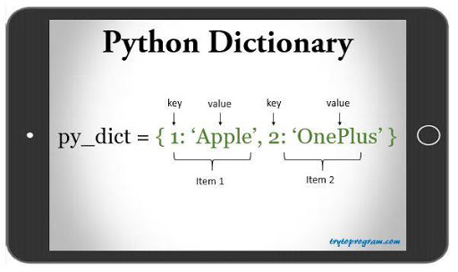
PYTHON DICTIONARIES

Slide 2
DEFINITONS
A dictionary is a collection which is unordered, changeable and “key” - indexed.
In Python dictionaries are written with curly brackets, and they have keys and values.

Slide 3
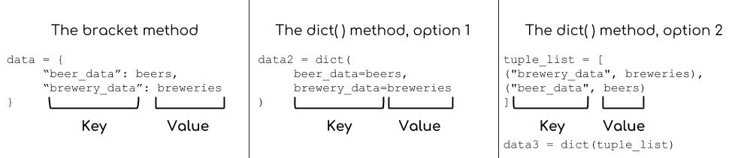
DEFINITONS
Dictionaries are Python’s implementation of a data structure that is more generally known as an associative array.

Slide 4
Dictionary is a built-in Python Data Structure that is mutable. It is similar in spirit to List, Set, and Tuples. However, it is not indexed by a sequence of numbers but indexed based on keys and can be understood as associative arrays.

Slide 5
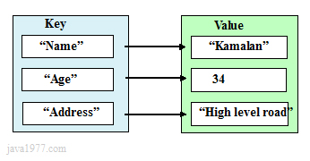
Dictionary key value illustration1

Slide 6
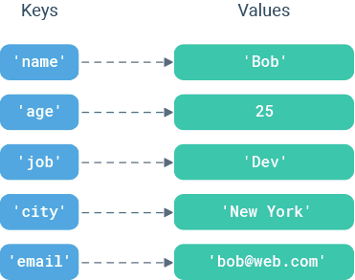
Dictionary key value illustration 2

Slide 7
On an abstract level, it consists of a key with an associated value. In Python, the Dictionary represents the implementation of a hash-table.

Slide 8
Ordered or Unordered?
As of Python version 3.7, dictionaries are ordered. In Python 3.6 and earlier, dictionaries are unordered.
When we say that dictionaries are ordered, it means that the items have a defined order, and that order will not change.
Unordered means that the items does not have a defined order, you cannot refer to an item by using an index.

Slide 9
Changeable
Dictionaries are changeable, meaning that we can change, add or remove items after the dictionary has been created.
Duplicates Not Allowed
Dictionaries cannot have two items with the same key:

Slide 10
CREATE A DICTIONARY
Python dictionary is an unordered collection of key-value pairs. It is mutable and can contain mixed types. The keys in a dictionary must be immutable objects like strings or numbers. They must also be unique within a dictionary.
One way to create a dictionary is to form an empty dictionary and later add new pairs.

Slide 11
Alternative method
You can define a dictionary by enclosing a comma-separated list of key-value pairs in curly braces ({}).
A colon (:) separates each key from its associated value:
d = { <key> : <value> ,<key> : <value> , <key> : <value> ,<key> : <value> ,}

Slide 12
Example
released = {"iphone" : 2007,"iphone 3G" : 2008,"iphone 3GS" : 2009,"iphone 4" : 2010,"iphone 4S" : 2011,"iphone 5" : 2012}
print released

Slide 13
Example
mydict = {'StuName': 'Ajeet', 'StuAge': 30, 'StuCity': 'Agra'}

Slide 14
Properties of Dictionary Keys
More than one entry per key is not allowed ( no duplicate key is allowed)
The values in the dictionary can be of any type, while the keys must be immutable like numbers, tuples, or strings
Dictionary keys are case sensitive - Same key name but with the different cases are treated as different keys in Python dictionaries.

Slide 15
Dictionaries and lists share the following characteristics:
Both are mutable.
Both are dynamic. They can grow and shrink as needed.
Both can be nested. A list can contain another list. A dictionary can contain another dictionary. A dictionary can also contain a list, and vice versa.

Slide 16
Dictionaries differ from lists primarily in how elements are accessed: Other keyfeatures
List elements are accessed by their position in the list, via indexing.
Dictionary elements are accessed via keys.More than one entry per key is not allowed ( no duplicate key is allowed)
The values in the dictionary can be of any type, while the keys must be immutable like numbers, tuples, or strings.
Dictionary keys are case sensitive- Same key name but with the different cases are treated as different keys in Python dictionaries.

Slide 17
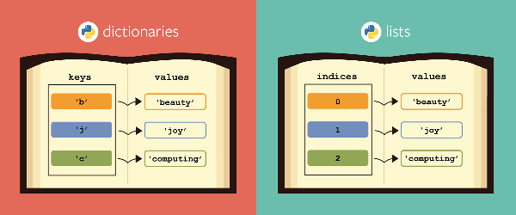
Accessing Items in a dictionary

Slide 18
Consider the dictionary
a dictonary data of car model
carmodel = {
"brand": "Ford",
"model": "Mustang",
"year": 1964
}
to access the model :

Slide 19
Consider the dictionary
a dictonary data of car model
carmodel = { "brand": "Ford", "model": "Mustang", "year": 1964}
to access the model we use :
carmodel[‘model’]

Slide 20
Changing the value of Items
in a dictonary data of car model
carmodel = {
"brand": "Ford", "model": "Mustang",
"year": 1964
}

Slide 21
Change the value of Items
in the dictonary data of car model You can change the value of a specific item by referring to its key name:
carmodel = {
"brand": "Ford",
"model": "Mustang",
"year": 1964
}

Slide 22
carmodel ["model"] = “Ford”

Slide 23
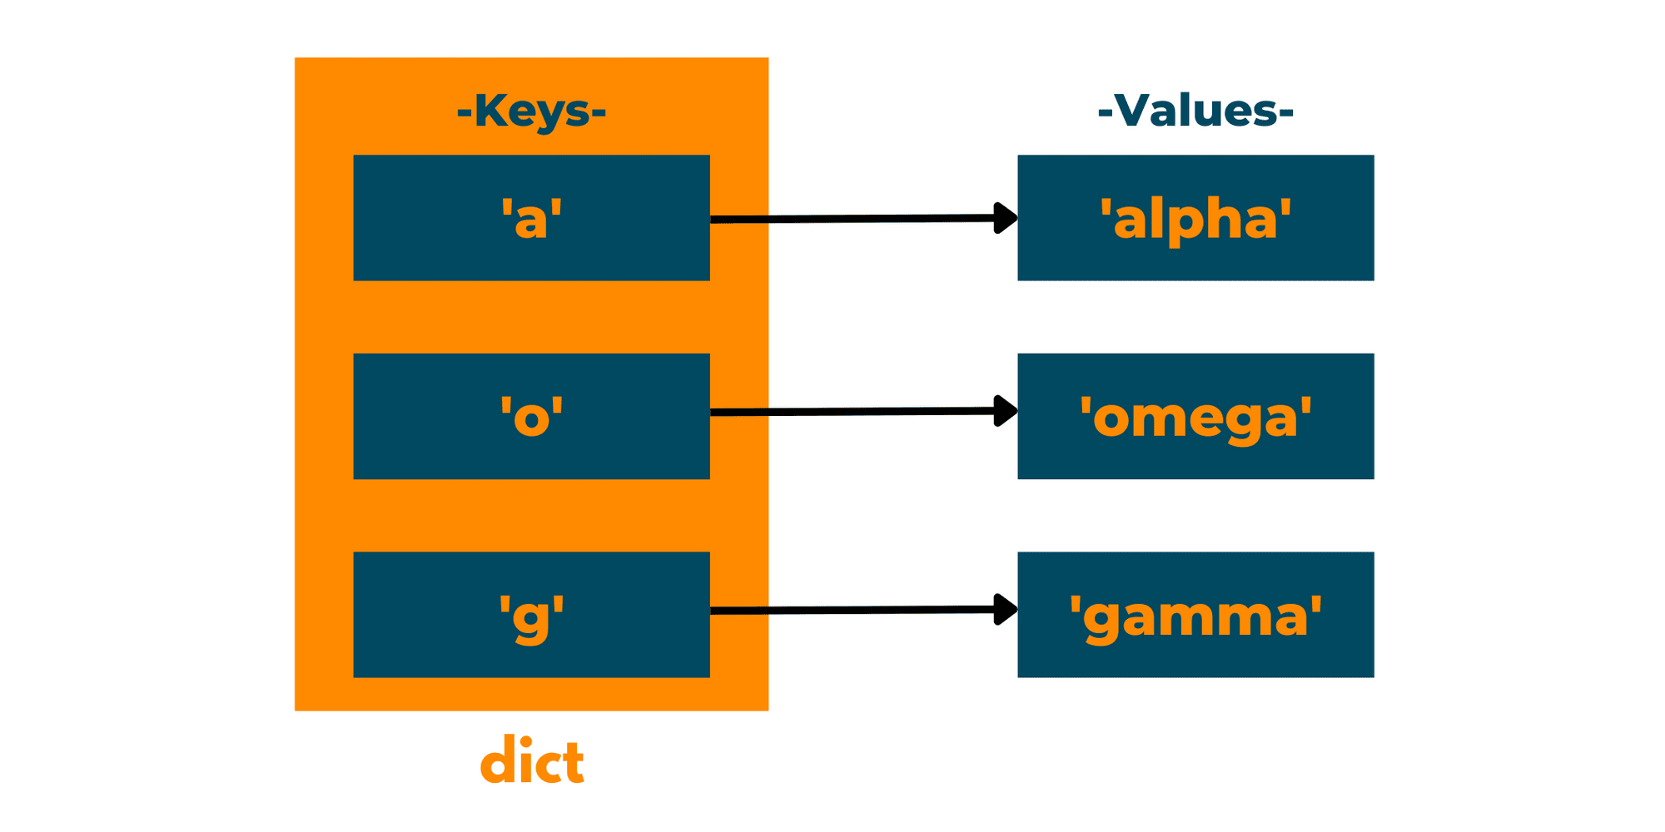
Loop through Items in a dictionary

Slide 24
Loop through Items in a dictionary-method 1
Print all key names in the dictionary, one by one:
released = {"iphone" : 2007,"iphone 3G" : 2008,"iphone 3GS" : 2009,"iphone 4" : 2010,"iphone 4S" : 2011,"iphone 5" : 2012}
for x in released:
print(x)

Slide 25
Loop through Items in a dictionary-method 2
Print all key names in the dictionary, one by one:
for x in released:
print(released[x])

Slide 26
Loop through Items in a dictionary-method 3
You can also use the values() method to return values of a dictionary:
for x in thisdict.values():
print(x)

Slide 27
Check if Key Exists in a dictionary

Slide 28
Check if Key Exists
To determine if a specified key is present in a dictionary use the in keyword:
Check if "model" is present in the dictionary:
carmodel = {
"brand": "Ford",
"model": "Mustang",
"year": 1964
}

Slide 29
use the “in” operator
if "model" in thisdict:
print("Yes, 'model' is one of the keys in the thisdict dictionary")

Slide 30
Dictionary Length

Slide 31
To determine how many items (key-value pairs) a dictionary has, you use the len() function.

Slide 32
Dictionary Length Example
team = {
'Abia State' : 'Abia Rockets',
'Abuja State' : 'Abuja FC',
'Anambra State': 'Anambra Pillars FC'
'Bayelse State': 'Bayels United FC',
'Enugu State' : 'Enugu Rangers'
}
len(team)

Slide 33
add item to Dictionary
devBio = {
"name": "lamide",
"age": 30,
"language": "JavaScript"
}
print(devBio)

Slide 34
add item to Dictionary
let us add ,another item
years of experieance
devBio[‘experience’] = 5

Slide 35
Update Dictionary
The update() method will update the dictionary with the items from a given argument. If the item does not exist, the item will be added.
The argument must be a dictionary, or an iterable object with key:value pairs.
studentData.update({“email": “reals@yahoo.com"})

Slide 36
Removing Items from a dictionary

Slide 37
There are several methods to remove items from a dictionary .
studentData.pop(“email")
studentData.pop(“email")

Slide 38
The popitem()
method removes the last inserted item (in versions before 3.7, a random item is removed instead):

Slide 39
Using Delete
The del keyword removes the item with the specified key name
The del keyword can also delete the dictionary completely:
del studentData["model"]

Slide 40
The clear() method
The clear() method empties the dictionary
studentData.clear()

Slide 41
Python - Loop Dictionaries
1 for x in studentData:
print(x)
2 Print all values in the dictionary, one by one:
for x in studentData:
print(studentData[x])

Slide 42
Python - Loop Dictionaries
3.
You can also use the values() method to return values of a dictionary:
for x in studentData.values():
print(x)

Slide 43
Python - Loop Dictionaries
4
You can use the keys() method to return the keys of a dictionary:
for x in studentData.keys():
print(x)

Slide 44
Python - Loop Dictionaries
5
Loop through both keys and values, by using the items() method:
for x, y in studentData.items():
print(x, y)

Slide 45
Copy a Dictionary
You cannot copy a dictionary simply by typing
dict2 = dict1,
because: dict2 will only be a reference to dict1, and changes made in dict1 will automatically also be made in dict2.
There are ways to make a copy, one way is to use the built-in Dictionary method copy(). Another way to make a copy is to use the built-in function dict().

Slide 46
Copy a Dictionary
mydict = dict(thisdict)

Slide 47
Copy a Dictionary
Make a copy of a dictionary with the copy() method:
New = studentData.copy()
New2= dict(studentData)

Slide 48
Nested Dictionaries
A dictionary can contain dictionaries, this is called nested dictionaries.

Slide 49
Nested Dictionaries
we can Create three dictionaries, then create one dictionary that will contain the other three dictionaries:

Slide 50
std1 = {
"name" : “Wale Thomson", “email" : ‘wale@yahoo.com’,
“matnos”:123456789 }
std2= {
"name" : “Adeniyi Michaels", “email" : ‘niyi@yahoo.com’,
“matnos”:10044678 }
std3 = {
"name" : “Adeola Medupine", “email" :’ adeola@yahoo.com’,
“matnos”:10044678 }

Slide 51
Nested Dictionaries
Students=
{
“std1" : std1,
“std2" : std2,
“std3" : std3
}

